Slide 1
Housing Subsidy Programs
ECON 3320 – Urban economics
Professor patrick button

Slide 2
In this chapter (Ch 7)
In this chapter we will examine a few policies that seek to make housing more affordable and accessible. We will look at:
1) housing subsidies
2) rent control
3) homelessness

Slide 3
Housing Subsidies
An alternative to rent control is using government funds to explicitly subsidize housing consumption.
Housing subsidies can be targetted towards low-income groups (unlike rent control which does not explicitly target low income groups).

Slide 4
Two Possible Goals of Housing Subsidies
1) Increase standard of living for low-income families (likely the primary goal)
2) Provide incentives to improve housing, particularily in low-income areas (“slums”).

Slide 5
Types of Subsidies
1) Proportion rent subsidy (PRS) – The government pays a fraction of the rent bill. This fraction is β. So the household pays (1- β) times the rent. E.g., β could be 0.3 (30%).
2) Income Grant (IG) – The government gives households a lump sum of money. This lump sum does not depend on housing consumption. This is simply an income boost (increase in y).
3) Housing Voucher (HV) – The government gives households vouchers that function like “food stamps” except they can only be spend on housing. It’s like a gift certificate for housing.
4) Public Housing (PH) – Families rent housing units for the government. The housing units are typically priced below market rent and are often higher quality.

Slide 6
Proportion Rent Subsidy
The government pays a fraction of the rent bill.
This fraction is β. β is between 0 and 1.
So the household pays (1- β) times the rent. E.g., β could be 0.4 (40%).
As before, families choose between housing (q) and “bread” (c).
The price of housing is p, and the price of bread is 1.
With a proportion rent subsidy, the price of housing goes from p to (1- β)p.

Slide 7
Budget Constraint
Total Expenditure = Disposable Income
Price of Bread x Quantity of Bread + Price of Housing x Quantity of Housing = y
c + pq = y

Slide 8
Budget Constraint
c + pq = y
Let’s use this to plot the budget line.
On the x-axis we will put c, and on the y-axis we will put q
(Note that earlier we had the axis reversed)

Slide 9
Budget Constraint
c + pq = y
Rearranging to solve for q as a function of c, y, and p:
pq = y – c
q = y/p – c/p
This gives us an equation for a budget line that we can plot.

Slide 10
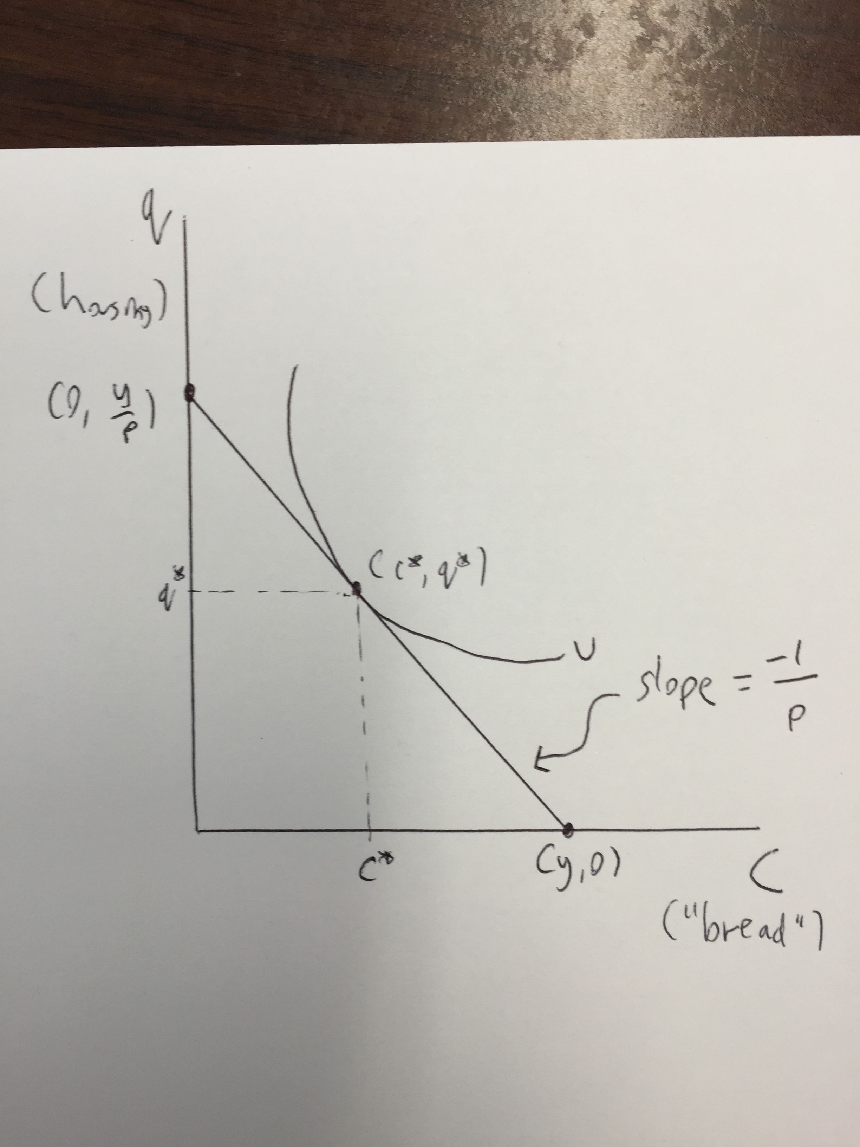
Plotting the budget line
To plot the budget line, you just need two points.
X-axis intercept occurs where q = 0. Solving for c:
q = y/p – c/p
0 = y/p – c/p
c/p = y/p
c = y
This gives the point (y, 0)

Slide 11
Plotting the budget line
To plot the budget line, you just need two points.
Y-axis intercept occurs where c = 0. Solving for q:
q = y/p – c/p
q = y/p – 0/p
q = y/p
This gives the point (0, y/p)

Slide 12
Choice between c and q
The optimal choice between c and q, given the income, y, and the price of housing p, occurs at the tangency between the budget line and the indifference curve.
This point is (c*, q*).

Slide 13
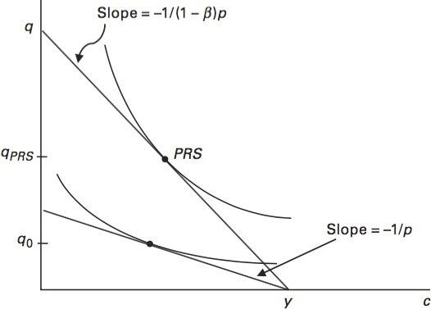
Adding a Proportional Rent Subsidy (PRS)
The PRS changes the price of housing from p to (1 – β)p.
The budget line rotates outward.
The x-axis intercept stays the same (0, y).
The y-axis intercept increases, since that point is y/p which changes to y/ (1 – β)p.
The slope is now -1/(1 – β)p instead of -1/p

Slide 14
Adding a Proportional Rent Subsidy (PRS)
Both c and q increase, but q increases a lot more.
Two factors are at play when the price decreases:
Substitution effect: q becomes cheaper, so consume more q and less c
Income effect: when prices decrease, this leads to an increase in purchasing power in a similar manner to if income had increased. This increases both c and q.
(You’ll cover income vs substitution effect in more detail in intermediate microeconomics)

Slide 15
Adding a Proportional Rent Subsidy (PRS)
Substitution effect: q becomes cheaper, so consume more q and less c
Income effect: when prices decrease, this leads to an increase in purchasing power in a similar manner to if income had increased. This increases both c and q.
The substitution effect decreases c, while the income effect increases c. Which effect dominates? It depends on which effect, income or substitution, is larger. In the figure, the income effect is slightly larger, showing a slight net increase in c.

Slide 16
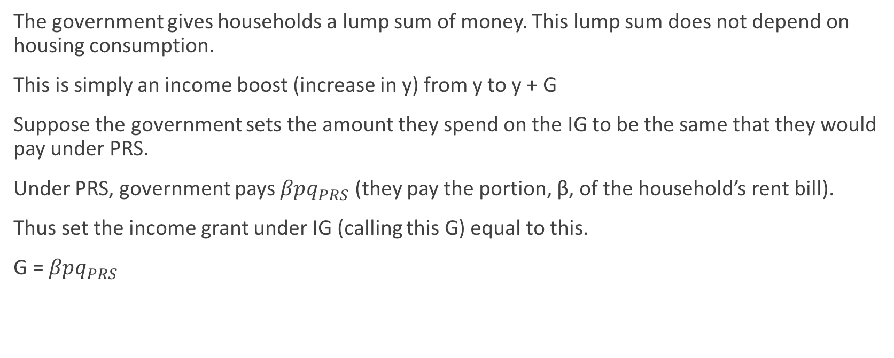
Income Grant (IG)
The government gives households a lump sum of money. This lump sum does not depend on housing consumption.
This is simply an income boost (increase in y) from y to y + G
Suppose the government sets the amount they spend on the IG to be the same that they would pay under PRS.
Under PRS, government pays $βpq_{PRS}$ (they pay the portion, β, of the household’s rent bill).
Thus set the income grant under IG (calling this G) equal to this.
G = $βpq_{PRS}$

Slide 17
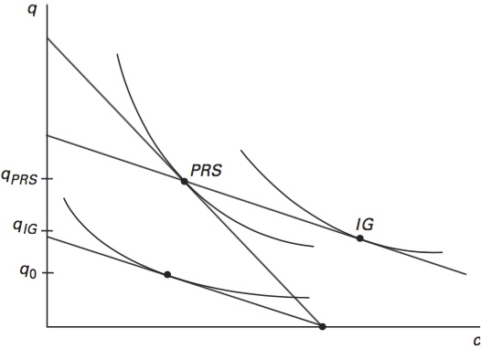
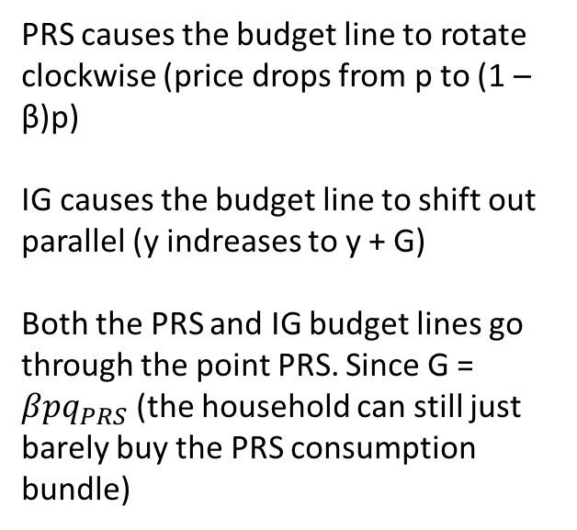
PRS vs IG
PRS causes the budget line to rotate clockwise (price drops from p to (1 – β)p)
IG causes the budget line to shift out parallel (y indreases to y + G)
Both the PRS and IG budget lines go through the point PRS. Since G = $βpq_{PRS}$ (the household can still just barely buy the PRS consumption bundle)

Slide 18
Utility Under IG is Higher
Utility is higher under the IG than the PRS. This is because IG comes with no strings attached, so the household can spend it however they like to increase utility.
The PRS costs the same for government but it constraints households to only get benefits via a price reduction.

Slide 19
Slum Reduction under PRS is stronger
Under PRS, housing consumption is higher. This means that slum-reduction effect is greater because families demand better housing.

Slide 20
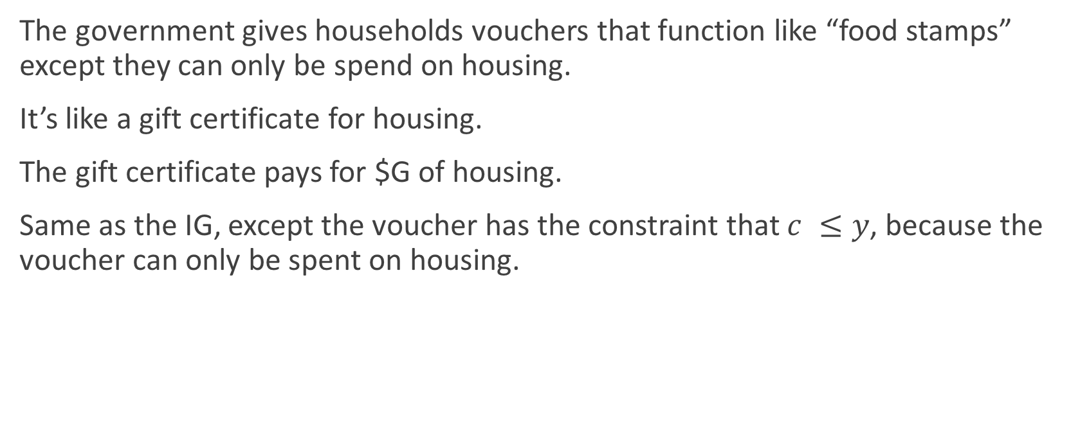
Housing Voucher (HV)
The government gives households vouchers that function like “food stamps” except they can only be spend on housing.
It’s like a gift certificate for housing.
The gift certificate pays for $G of housing.
Same as the IG, except the voucher has the constraint that $c ≤y$, because the voucher can only be spent on housing.

Slide 21
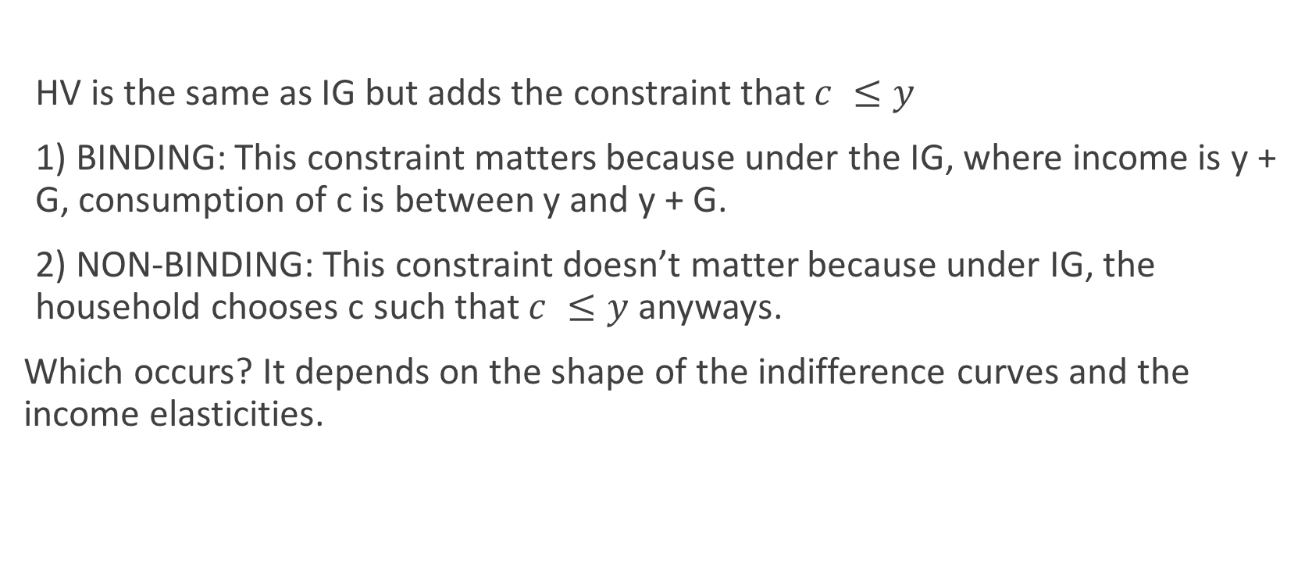
HV vs IG, two cases
HV is the same as IG but adds the constraint that $c ≤y$
1) BINDING: This constraint matters because under the IG, where income is y + G, consumption of c is between y and y + G.
2) NON-BINDING: This constraint doesn’t matter because under IG, the household chooses c such that $c ≤y$ anyways.
Which occurs? It depends on the shape of the indifference curves and the income elasticities.

Slide 22
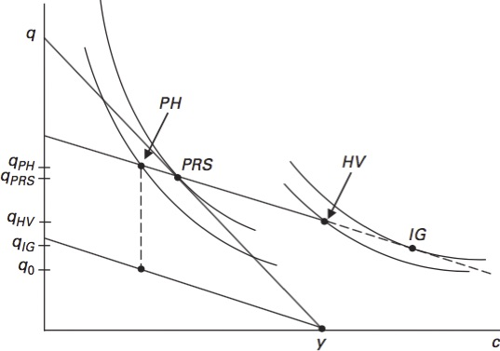
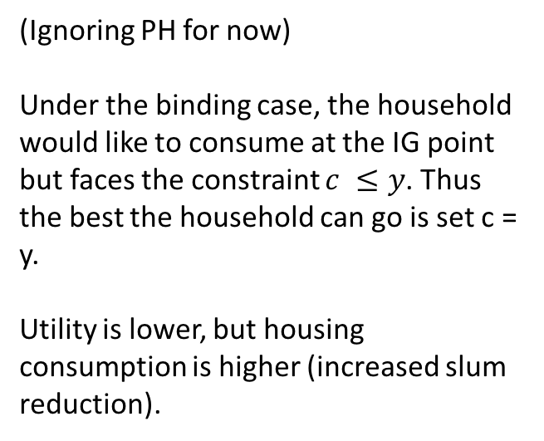
Binding case: HV vs IG
(Ignoring PH for now)
Under the binding case, the household would like to consume at the IG point but faces the constraint $c ≤y$. Thus the best the household can go is set c = y.
Utility is lower, but housing consumption is higher (increased slum reduction).

Slide 23
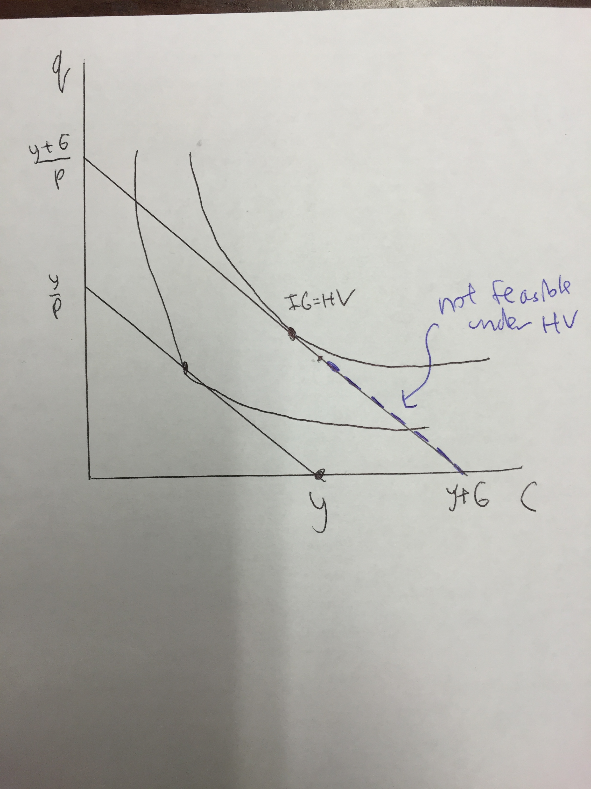
Non-Binding Case: HV = IG
In the non-binding case, the household doesn’t consume/spend more than y on c even after the IG increases their income from y to y + G.
The IG and HV programs lead to the same outcome.
Note that since households have difference preferences, the constraint may bind for some and not others.

Slide 24
Public Housing (PH)
Families rent housing units for the government.
The government charges rent for these housing units at a rate below the market rent.
To allow an easier comparison between PH and PRS, IG, and HV, suppose that the household pays the same total rent bill in the original case (no programs) and under PH.
The government simply gives families a larger dwelling (higher q) for the same price.
This leads to an increase in q but no change in c.

Slide 25
Public Housing (PH)
To keep the expenditure on all programs the same, the government spends G to make the dwellings larger.
Assuming that government can build housing at cost p per ft2 (the market price), the increase in q is the the same budget line as the budget line with IG (which income is y + G instead of just y). The figure assumes this case.
If government can only build housing at a higher cost than p (perhaps the government is inefficient) then the increase in q isn’t quite as high.

Slide 26
Public Housing (PH) in the Figure
The consumer’s budget set is a bit weird in this case. Either they reject the public housing and consume on the original budget line (the low one), or they pick the point PH.
They will pick PH since the utility is much higher there.
Under PH, q increases from q0 to qPH.
No change in c.
Families are essentially just given more q.

Slide 27
Public Housing (PH) in the Figure
Suppose we drew the budget line for IG (where income is y + G). This goes through the point PH.
The point PH lies on an indifference curve that is NOT tangent to this budget line. The tangency actually occurs at IG.
What this means is that if the household were given a grant G instead of getting $G worth of housing, they would chose to increase both q and c, not just c.
So PH imposes the largest constraint on consumption choice.

Slide 28
Comparing all Four - Utility
IG has the highest utility because it places no restriction of consumer choice.
HV is next best. It is either the same as IG (non-binding case) or leads to less utility since c must equal y.
PRS is third. A price decrease instead of a voucher is more restrictive, so utility is lower.
PH has the smallest increase in utility. This is because the same amount of money (G) is spent to only increase housing. Relative to the other three policies, this is extremely restrictive to consumer choice.

Slide 29
Comparing all Four – Slum Reduction
Exact opposite order!
IG poses no restrictions, so the increase in q is the lowest.
HV increases q a bit more than IG does in the binding case.
PRS increases q quite a bit more by making it cheaper through a subsidy.
PH increases q very directly, by building better housing. Avoids a market-based approach to increasing q as in the other three policies.

Slide 30
Public Housing in Practice
Public Housing continues to be popular. However, while public housing does lead to the largest increase in q, critics don’t like PH because it concentrates poor people together, leading to neighborhoods with more crime and social issues.
More recent practice has PH units more spread out, or PH units are mixed income. “Mixed income” means that the government intentionally rents out some proportion of units to those of high income, usually with only a very mild subsidy (while the low-income results get the full subsidy).

Slide 31
Example: Housing Authority of New Orleans
See the website: http://www.hano.org/communities.aspx

Slide 32
Low-Income Housing Tax Credit (LIHTC)
While not exactly a PRS, the Low-Income Housing Tax Credit (LIHTC, pronounced “lie-tech”) has similar effects.
LIHTC was created under the Tax Reform Act of 1986.
LIHTC accounts for about 90% of all affordable rental housing created in the United States today.
LIHTC provides a subsidy for building developers when they build low-income housing. The subsidy is given on the condition that the developers build a certain number of units that are occupied by low income households at reduced rents.
This the LIHTC subsidies housing developers who make low-income housing, rather than subsidizing the price of housing for low-income individuals.
Source: https://en.wikipedia.org/wiki/Low-Income_Housing_Tax_Credit

Slide 33
Section 8
Refers to Section 8 of the Housing Act of 1937 (42 U.S.C. § 1437f)
Primary part of Section 8 is the Housing Choice Voucher which pays a large portion of the rents and utilities of about 2.1 million households. (source: https://en.wikipedia.org/wiki/Section_8_(housing))
Vouchers can be applied to housing units that meet a minmum housing quality standard.

Slide 34
Eligibility for Section 8
“Eligibility for a housing voucher is determined by the PHA based on the total annual gross income and family size and is limited to US citizens and specified categories of non-citizens who have eligible immigration status. In general, the family's income may not exceed 50% of the median income for the county or metropolitan area in which the family chooses to live. By law, a PHA must provide 75 percent of its voucher to applicants whose incomes do not exceed 30 percent of the area median income. Median income levels are published by HUD and vary by location. The PHA serving your community can provide you with the income limits for your area and family size.”
Source: U.S. Department of Housing and Urban Development, “Housing Choice Vouchers Fact Sheet”: http://portal.hud.gov/hudportal/HUD?src=/topics/housing_choice_voucher_program_section_8

Slide 35
Section 8 In Practice
Section 8’s Housing Choice Voucher isn’t a housing voucher program like the one we discussed.
The Housing Choice Voucher pays a portion of the rent directly to the landlord and the families that get the voucher only pay 30% of their income in rent.
The payment to the landlord is based on a computation of the “fair market rent” for a housing unit that is large enough for the family.
“Fair market rent” is based on local market conditions.
The subsidy equals “fair market rent” minus 30% of the household’s income. This is a positive number since these low-income families have low household income, so 30% of that is a small number.
So Section 8’s Housing Choice Voucher is similar to a PRS.

Slide 36
Section 8 in New Orleans
See http://www.hano.org/housing.aspx

